Slide 1

Selected Topics in Computational Intelligence I
Session Enrichment 3 –Guest Lecture
Articial Immune System

Slide 2
Agenda
Nature Immune Systems
Antigen
lympochyte
Artificial Immune Systems

Slide 3
Nature Immune Systems
The natural immune system (NIS) has an amazing pattern matching ability, used to distinguish between foreign cells entering the body (referred to as non-self, or antigen) and the cells belonging to the body (referred to as self).
As the NIS encounters antigen, the adaptive nature of the NIS is exhibited, with the NIS memorizing the structure of these antigen for faster future response the antigen.

Slide 4
Artificial Immune Systems
An artificial immune system (AIS) models the natural immune system’s ability to detect cells foreign to the body.
The result is a new computational paradigm with powerful pattern recognition abilities, mainly applied to anomaly detection.

Slide 5
Concept
The classical view of the immune system is that the immune system distinguishes between what is normal (self) and foreign (non-self or antigen) in the body.
The recognition of antigens leads to the creation of specialized activated cells, which inactivate or destroy these antigens. The natural immune system mostly consists of lymphocytes and lymphoid organs.
Antigens are material that can trigger immune response. An immune response is the body’s reaction to antigens so that the antigens are eliminated to prevent damage to the body. Antigens can be either bacteria, fungi, parasites and/or viruses.

Slide 6
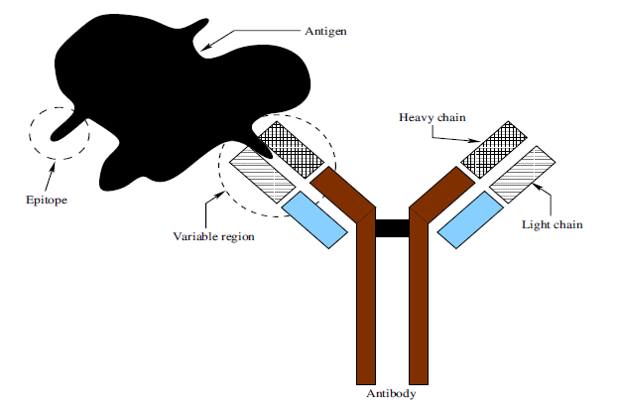
Antigen-Antibody complex
All cells in the body are created in the bone marrow.
white cells known as phagocytes. Phagocytes include monocytes, macrophages and neutrophils.
Macrophages are versatile cells that secrete powerful chemicals and play an important role in T-Cell activation.

Slide 7
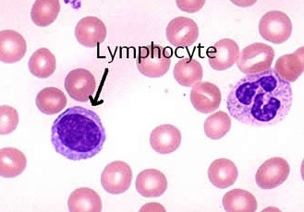
Lymphocytes
A lymphocyte is white blood cell in a our immune system. The three major types of lymphocyte are T cells, B cells and natural killer (NK) cells. Lymphocytes can be identified by their large nucleus.
T cells (thymus cells) and B cells (bursa-derived cells) are the major cellular components of the adaptive immune response

Slide 8
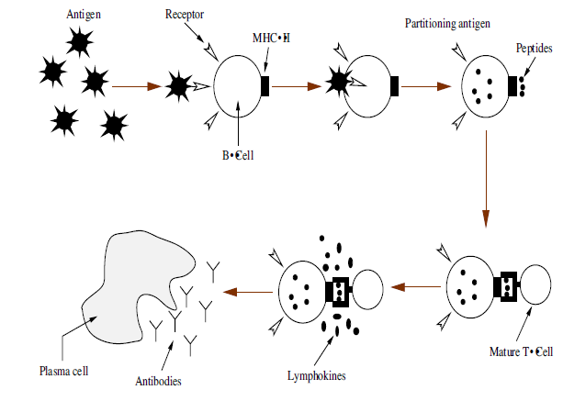
Lifecycle of Lymphocytes
Both T-Cells and B-Cells secrete lymphokines and macrophages secrete monokines. Monokines and lymphokines are known as cytokines and their function is to encourage cell growth, promote cell activation or destroy target cells.
When a B-Cell’s receptor matches an antigen, the antigen is partitioned into peptides.

Slide 9
When a B-Cell’s receptor matches an antigen, the antigen is partitioned into peptides . The peptides are then brought to the surface of the B-Cell by an MHC-molecule of Type II. Macrophages also break down antigen and the broken down antigen is brought to the surface of the macrophage.
The HTC binds to the MHC-molecule on the surface of the B-Cell or macrophage and proliferates or suppresses the B-Cell response to the partitioned cell, by secreting lymphokines.

Slide 10
Concept
An antigen must be recognized as foreign (non-self).
Every cell has a huge variety of antigens in its surface membrane.
Antibodies are chemical proteins. In contradiction to antigens, antibodies form part of self and are produced when lymphocytes come into contact with antigen (nonself).
An antibody has a Y-shape (as shown Figure). Both arms of the Y consist of two identical heavy and two identical light chains.

Slide 11
Immunity Types
Active naturally-obtained immunity: Due to memory-cells, active naturally obtained immunity is more or less permanent.
Passive naturally-obtained immunity: Passive naturally-obtained immunity is short-lived since antibodies are continuously broken down without creation of new antibodies.
Active artificially-obtained immunity: Active artificially-obtained immunity develops when dead organisms or weakened organisms are therapeutically applied.

Slide 12
The Network Theory
The network theory was first introduced by Jerne, and states that B-Cells are interconnected to form a network of cells.
When a B-Cell in the network responds to a foreign cell, the activated B-Cell stimulates all the other B-Cells to which it is connected in the network.
Thus, a lymphocyte is not only stimulated by an antigen, but can also be stimulated or suppressed by neighboring lymphocytes, i.e. when a lymphocyte reacts to the stimulation of an antigen, then secretion of antibodies.

Slide 13
The Danger Theory
The main idea of the danger theory is that the immune system distinguishes between what is dangerous and nondangerous in the body.

Slide 14
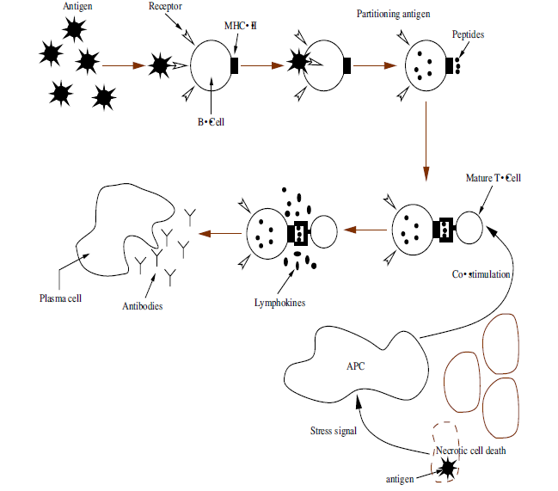
Co-Stimulation of T-Cell by an APC
Although cell death is common within the body, the immune system only reacts to those cell deaths that are not normal programmed cell death (apoptosis), i.e. nonapoptotic or necrotic deaths.
When a cell is infected by a virus, the cell itself will send out a stress signal (known as signal 0) of necrotic death to activate the antigen presenting cells (APCs)

Slide 15
Capabilities of the NIS within each theory, are summarized below:
The NIS only needs to know the structure of self/normal cells. The NIS can distinguish between self and foreign/non-self cells.
A foreign cell can be sensed as dangerous or non-dangerous.
Lymphocytes are cloned and mutated to learn and adapt to the structure of the encountered foreign cells.

Slide 16
Artificial Immune System Algorithm
To model an AIS, there are a few basic concepts that must be considered:
There are trained detectors (artificial lymphocytes) that detect non-self patterns with a certain affinity.
The artificial immune system may need a good repository of self patterns or self and non-self patterns to train the artificial lymphocytes (ALCs) to be self tolerant.
The affinity between an ALC and a pattern needs to be measured. The measured affinity indicates to what degree an ALC detects a pattern.

Slide 17
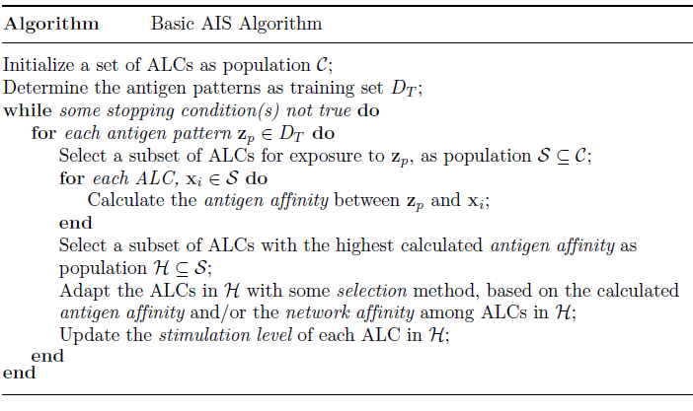
AIS Algorithm

Slide 18
Negative Selection
The process of deleting self-reactive lymphocytes is termed clonal deletion and is carried out via a mechanism called negative selection that operates on lymphocytes during their maturation.

Slide 19
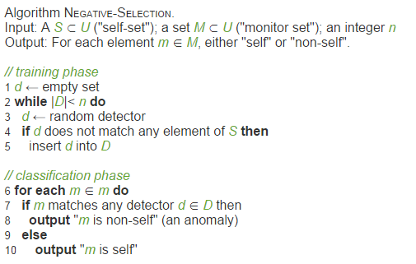
Negative Selection

Slide 20
Clonal Selection
According to Burnet's 1959 clonal selection theory, the immune system repertoire undergoes a selection mechanism during the lifetime of the individual. The theory states that on binding with a suitable antigen, activation of lymphocytes occurs.
The process of deleting self-reactive lymphocytes is termed clonal deletion and is carried out via a mechanism called negative selection that operates on lymphocytes during their maturation

Slide 21
ClonalG
The selection of a lymphocyte by a detected antigen for clonal proliferation, inspired the modeling of CLONALG. De Castro and Von Zuben presented CLONALG as an algorithm that performs machine-learning and pattern recognition tasks. All patterns are presented as binary strings.
The affinity between an ALC and a non-self pattern is measured as the Hamming distance between the ALC and the non-self pattern. The Hamming distance gives
an indication of the similarity between two patterns, i.e. a lower Hamming distance between an ALC and a non-self pattern implies a stronger affinity.

Slide 22
Intrusion Detection
The basic function of an intrusion detection system (IDS) is to monitor incoming traffic at a specific host connected to a network.
The IDS creates a profile of normal user traffic and signals an alarm of intrusion for any detected abnormal traffic, i.e. traffic not forming part of the normal profile. A problem to this solution of profile creation, is that the normal traffic changes through time. Thus, the profile gets outdated.

Slide 23
example
After the system has been initialized, the program begins a tiny simulation with six input patterns.
The first input is detected by lymphocyte 1, but because each lymphocyte has an activation threshold, the lymphocyte doesn’t trigger an alarm.
At time t = 3, lymphocyte 1 detects another suspicious input but, again, is not yet over the threshold. But at time t = 5, lymphocyte 1 detects a third suspicious input packet and a simulated alert is triggered.
Harmful items are proteins called antigens.

Slide 24
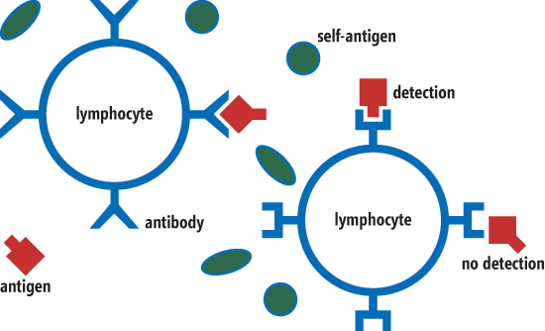
The antigens are colored red and have sharp corners. The human body also contains many non-harmful antigens called self-antigens, or self-items. These are naturally occurring proteins and are colored green and have rounded sides.

Slide 25
Antigens are detected by lymphocytes. Each lymphocyte has several antibodies, which can be thought of as detectors. Each antibody is specific to a particular antigen.
Typically, because antibody-antigen matching is only approximate, a lymphocyte will not trigger a reaction when a single antibody detects a single antigen.
Only after several antibodies detect their corresponding antigens will a lymphocyte become stimulated and trigger some sort of defensive reaction.

Slide 26
Real antibodies are generated by the immune system in the thymus, but any antibodies that detect self-items are destroyed before being released into the blood stream, a process called apoptosis.
In terms of an intrusion-detection system, antigens correspond to TCP/IP network packets whose contents contain some sort of harmful data, such as a computer virus. Self-antigens correspond to normal, non-harmful network packets.

Slide 27
AIS Intrusion Detection
AIS intrusion detection works in the opposite way by maintaining a set of input patterns that are known to be non-harmful and then triggering an alert when an unknown pattern is detected.
This allows AIS intrusion-detection systems—in principle, at least—to detect new viruses.
A real AIS intrusion-detection system would collect many thousands of normal input patterns over the course of days or weeks.

Slide 28
References
Andries P. Engelbrect. (2007), Computational Intelligence An Introduction. 2nd Ed. John Wiley & Sons. USA. ISBN: 978-0-470-03561-0
James M. Keller, Derong Liu, David B. Fogel (2016). Fundamentals of Computational Intelligence. Neural Networks, Fuzzy Systems and Evolutionary Computation, Wiley ISBN 978-1-110-21434-2
Bansal, Jagdish Chand, Pramod Kumar Singh, and Nikhil R. Pal . (2017) "Evolutionary and Swarm Intelligence Algorithms", Springer, ISBN 978-3-319-91339-1
Bernhard, Korte, and J. Vygen (2008), "Combinatorial optimization: Theory and algorithms." Springer, Third Edition.

Slide 29
Thank You

